Slide 1
Video Compression Optimization using Machine Learning
Second Stage Evaluation
Guided By:
Dr. Rupa G. Mehta
Prepared By:
Alkesh Vaghela – U15CO039
Jay Dudhat – U15CO048
Priyansh Zalavadiya – U15CO050
Apurva Tripathi – U15CO097

Slide 2
Key points
Motivation
Working of HEVC
Analysis of static and dynamic background
Proposed framework
Feature extraction system
Future work

Slide 3
Motivation
Rapid development in field of video recording
High quality and large in size
Expertise requires in x265 encoder
Video
Compression
Optimization

Slide 4
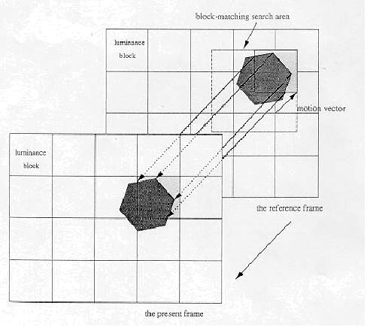
WORKING OF HEVC
Motion Estimation(ME)
Motion Compensation(MC)

Slide 5
Analysis

Slide 8
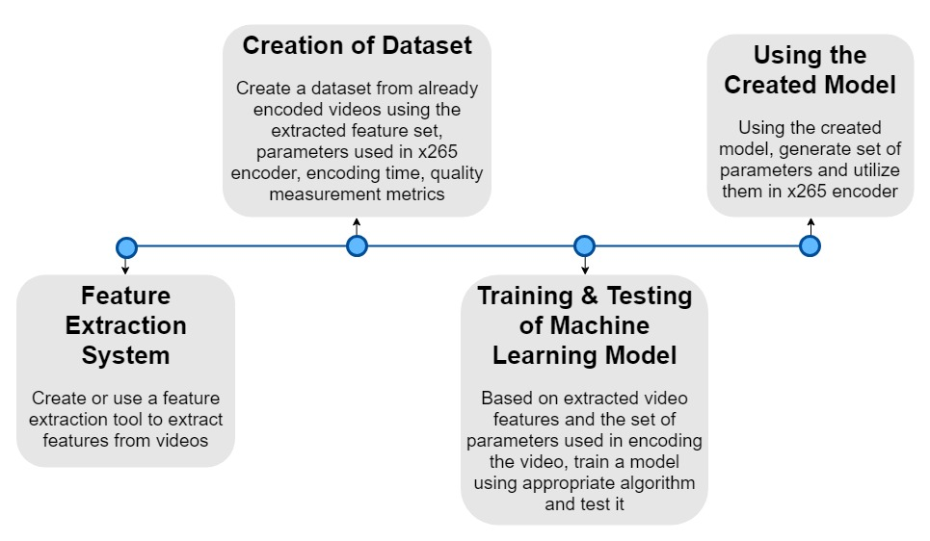
Proposed Framework

Slide 9
Feature Extraction System
Background Subtraction
Pearson Correlation Coefficient
Scene Change Detection
Intensity Matching

Slide 10
1. Background subtraction
Creating a Statistical Representation of the Background
Identifying Object Motion in Foreground by subtracting Consecutive frames

Slide 11
Gaussian Mixture Model

Slide 12
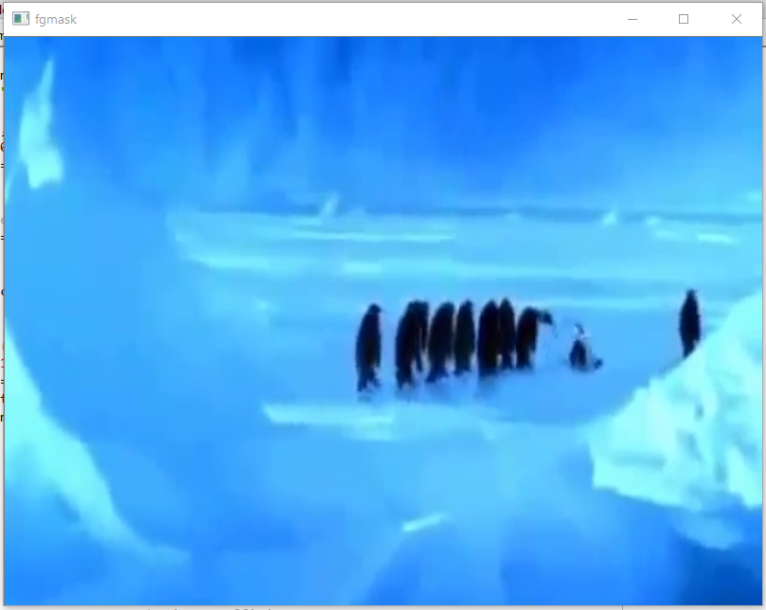
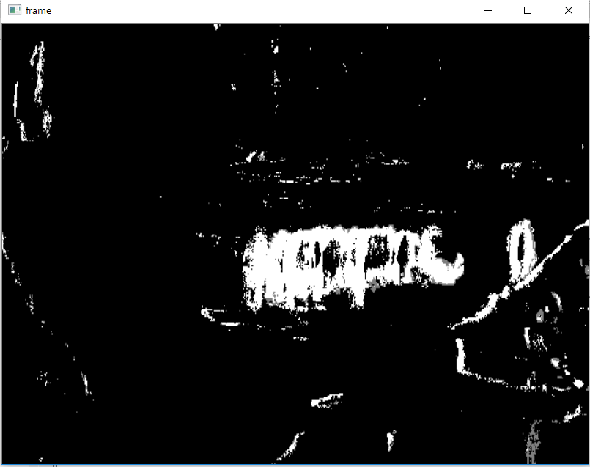
Frame Before Background Subtraction
Frame After Background Subtraction

Slide 13
2. Pearson Correlation Coefficient
Correlation between two variable sets
Value between +1 and -1
+1 = Total Positive Linear Correlation
0 = No Linear Correlation
-1 = Total Negative Linear Correlation
Pearsonr() :- Inbuilt Function of SciPy Library

Slide 14

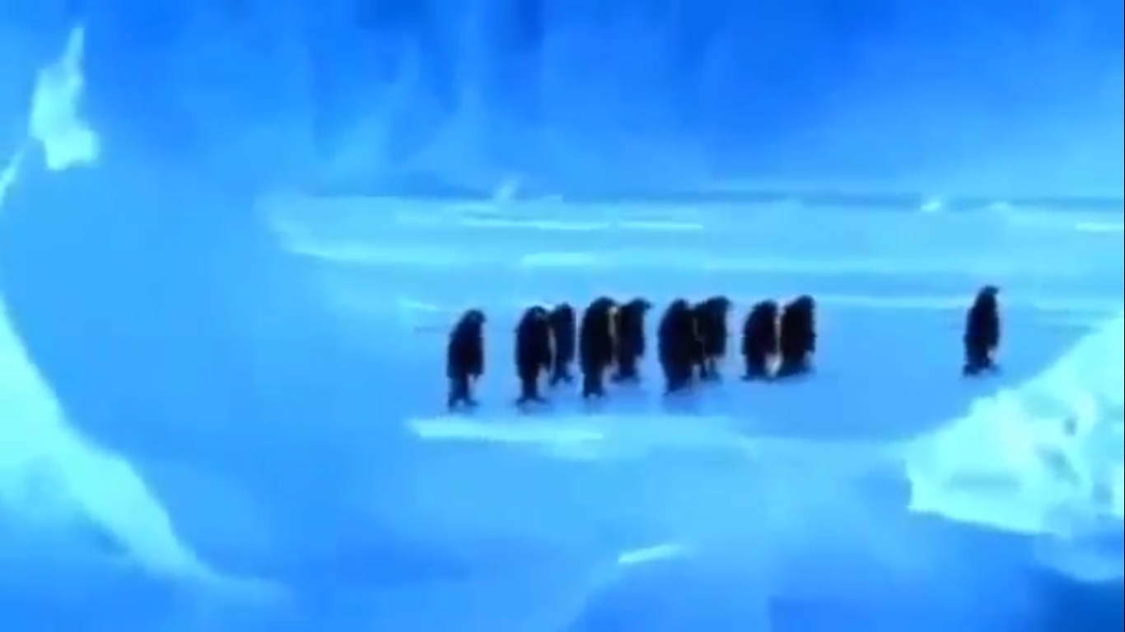
3. Scene change DETECTION
Entire Background Changes
Motion Feature to reach around 90 – 100 % for Roughly a Second

Slide 15
4. Intensity Matching
Using KNN method of FlannBasedMatcher
Find similar points on basis of Distance between their Values

Slide 16

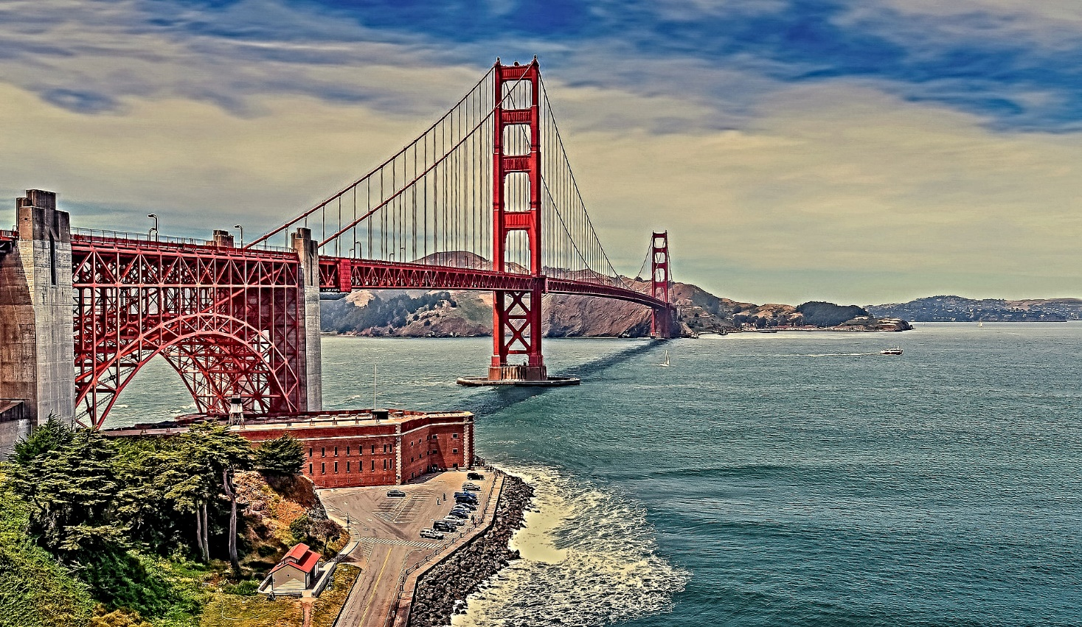
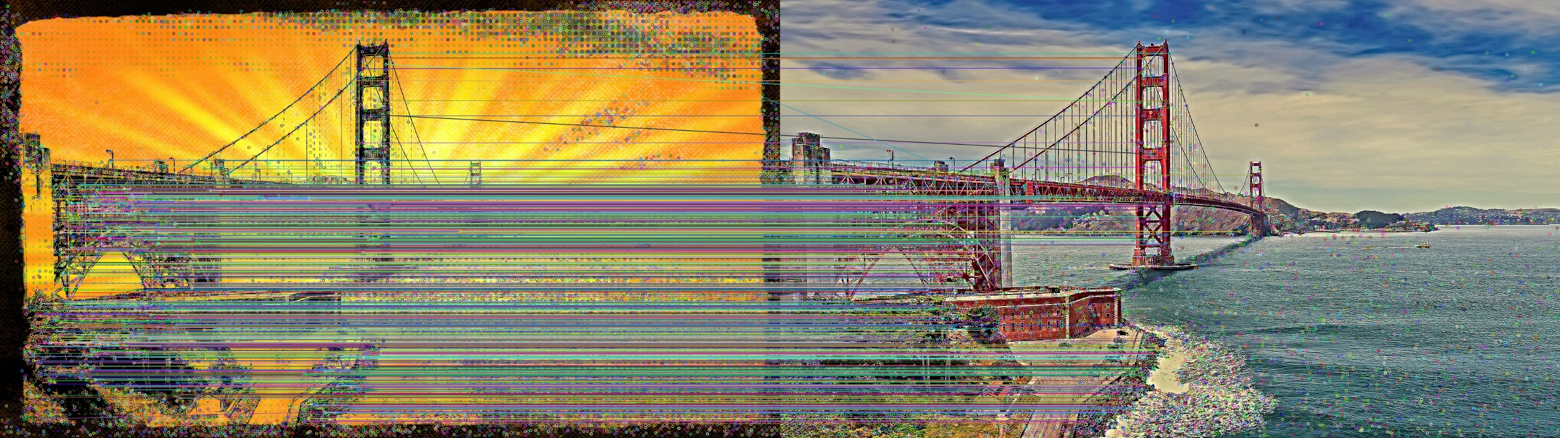

Slide 17
Future work
Video Classification Model based on extracted features.
Create optimal datasets to train the model.
By comparing and evaluating optimal machine learning approach for finding optimal parameters of x265 encoder.
Training of Machine Learning model based on obtained dataset.

